Slide 1
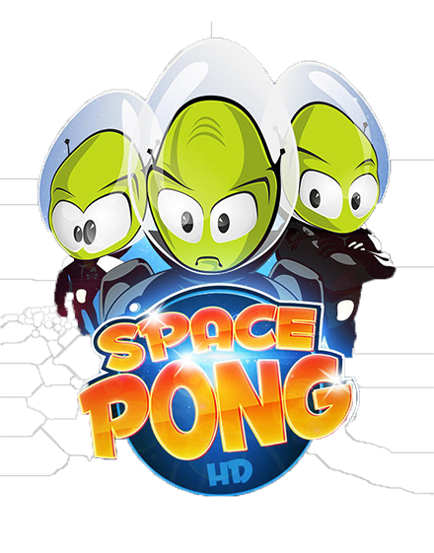
Space-pong
Presenter: Nirajan Mandal
Batch: 2073
Faculty: B.Sc.CSIT
Date: 2073/12/19

Slide 2
CONTENTS
INTRODUCTION
FLOWCHART
USER INTERFACE
HOW GAME WORKS
LIMITATIONS
RECOMMENDATION FOR FUTURE WORK

Slide 3
INTRODUCTION
Manufactured by Atari, released in 1972
Two-dimensional game that simulates table tennis
Paddles are used for playing
Winning clause: Five points

Slide 4
FLOWCHART
Start
B
A
Initialize SDL
If user presses 3
Display help and if pressed backspace
Yes
Display menu
Display Game over
No
If user presses 4
No
Display menu
If user presses 1
Display Images (paddles, ball, & wallpaper) and Play "Computer vs Player"
Yes
Yes
Clear and exit SDL and everything.
No
If user presses 2
Yes
Display Images (paddles, ball, & wallpaper) and Play "Player vs Player"
No
B
A

Slide 5
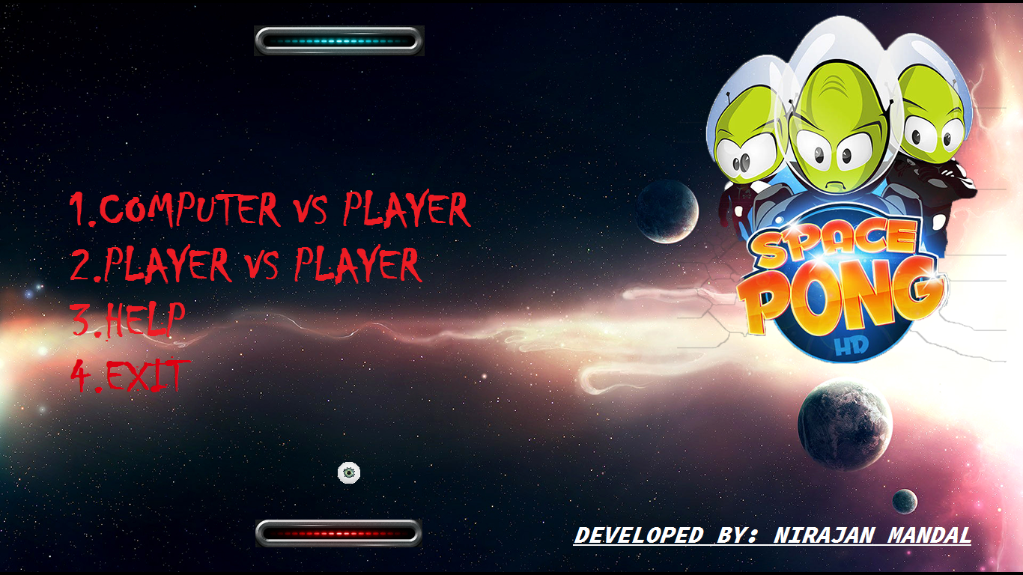
USER INTERFACE
Menu Screen

Slide 6
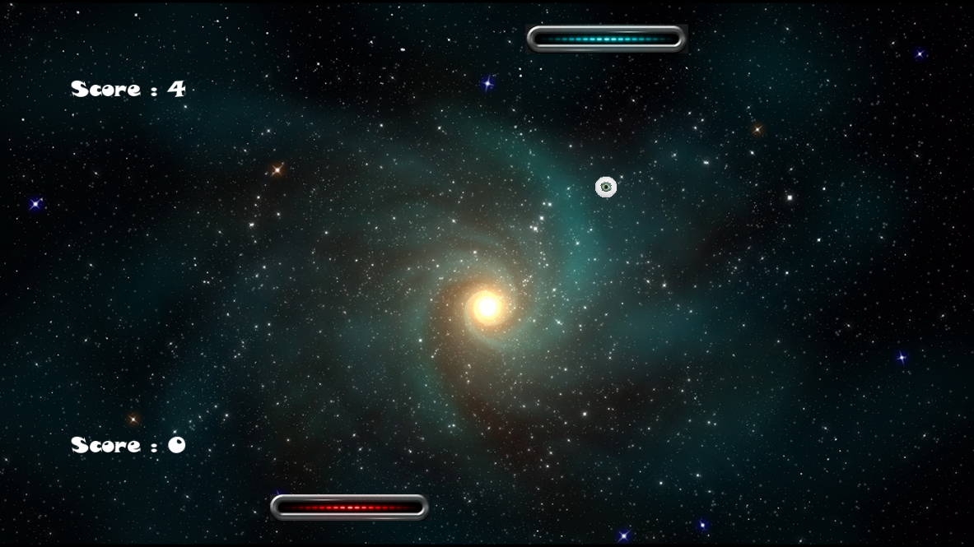
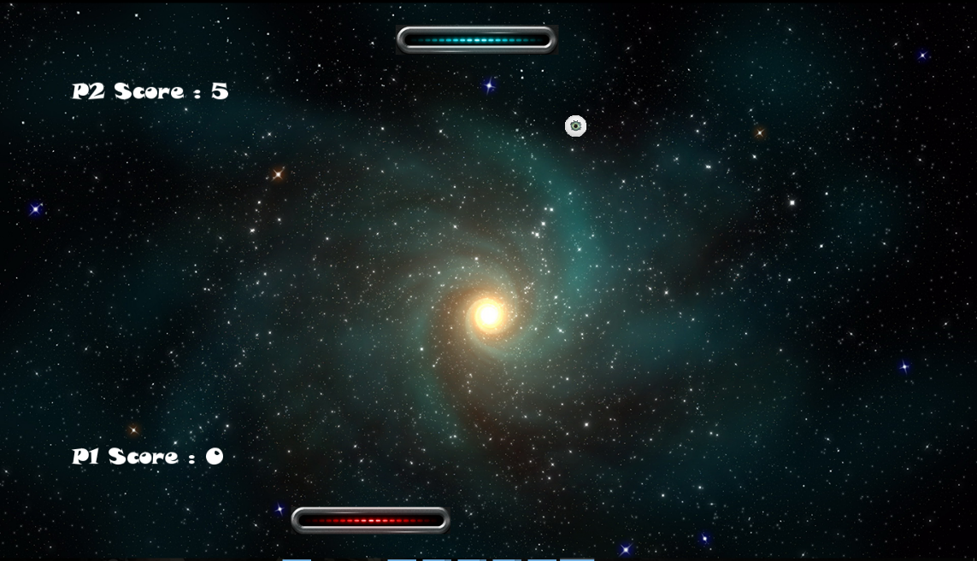
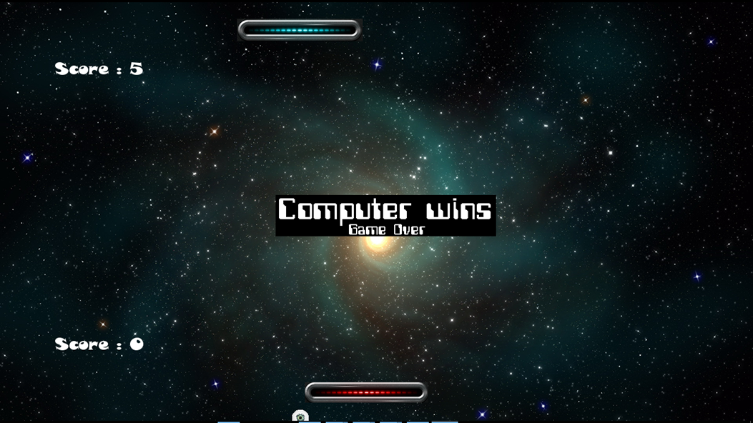
Computer vs Player mode
Player vs Player mode
Game Over

Slide 7
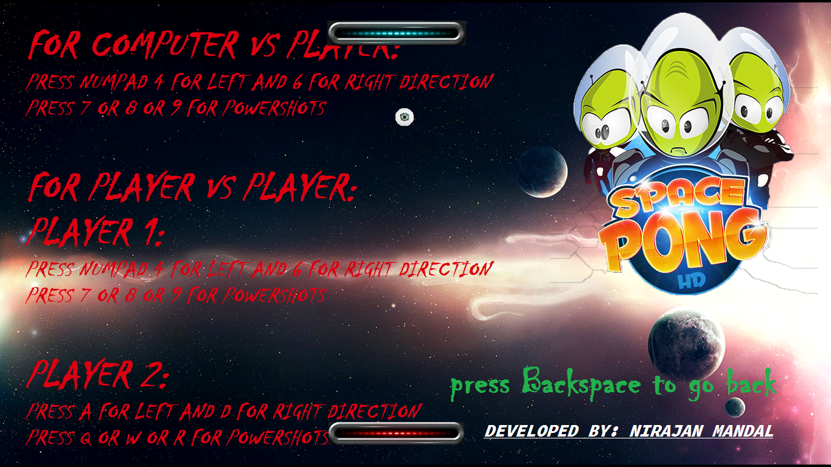
Help

Slide 8
HOW GAME WOKS
In Computer vs Player Mode:
Computer paddle moves by following the direction of the ball. It can do random power shots during gameplay.
Player's paddle moves using numpad keys i.e. 4 for left 6, for right and 7,8,9 for power shots.
In Player vs Player Mode:
Player 1 paddle moves pressing A for left, D for right and Q,W,E is for power shots.
Player 2 paddles moves pressing numpad keys i.e. 4 for left 6, for right and 7,8,9 for power shots.
Scoring:
The one who misses the ball through letting it run out of the boundary in his own side would lose that round, and the opposite side would gain one point. The one who gains 5 points first would win the whole game.

Slide 9
LIMITATIONS
CONCLUSION
Angle detection is not implemented
It does not have any timers
Pause and play is not implemented
No mouse implementation
RECOMMENDATION FOR FUTURE WORK
Angle detection scheme can be implemented
More attractive sounds, animations and images can be added
Taking input from mouse can also be implemented

Slide 10

ANY QUESTIONS?

